Slide 1

The Case Study on Ad Campaign
By Akshay Dahiya

Slide 2
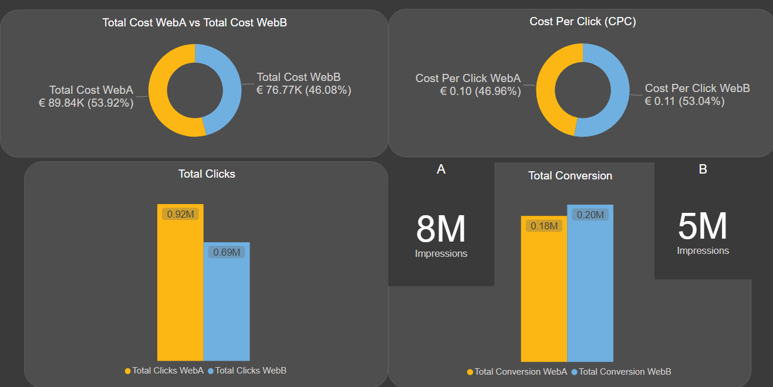
Overall Performance Between Website A and Website B.
From this comparison. We can see that Website B performance is much better than Website A. However, total clicks on Website A is more than Website B
Total Spend on Website B is lesser, and the conversion is higher.

Slide 3
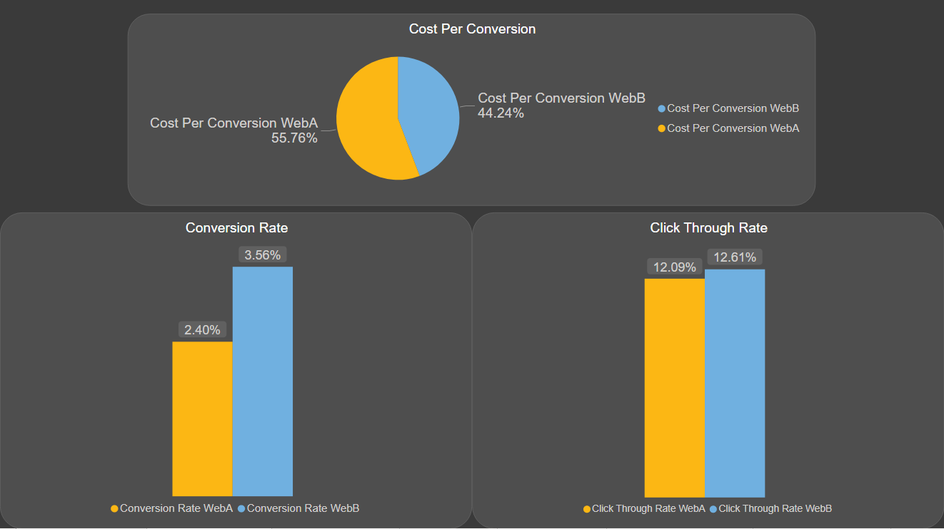
Cost Per Conversion (CPC) Is Higher on Website A by more than 11%.
Conversion rate and Click Through Rate of Website B is higher than Website A.

Slide 4
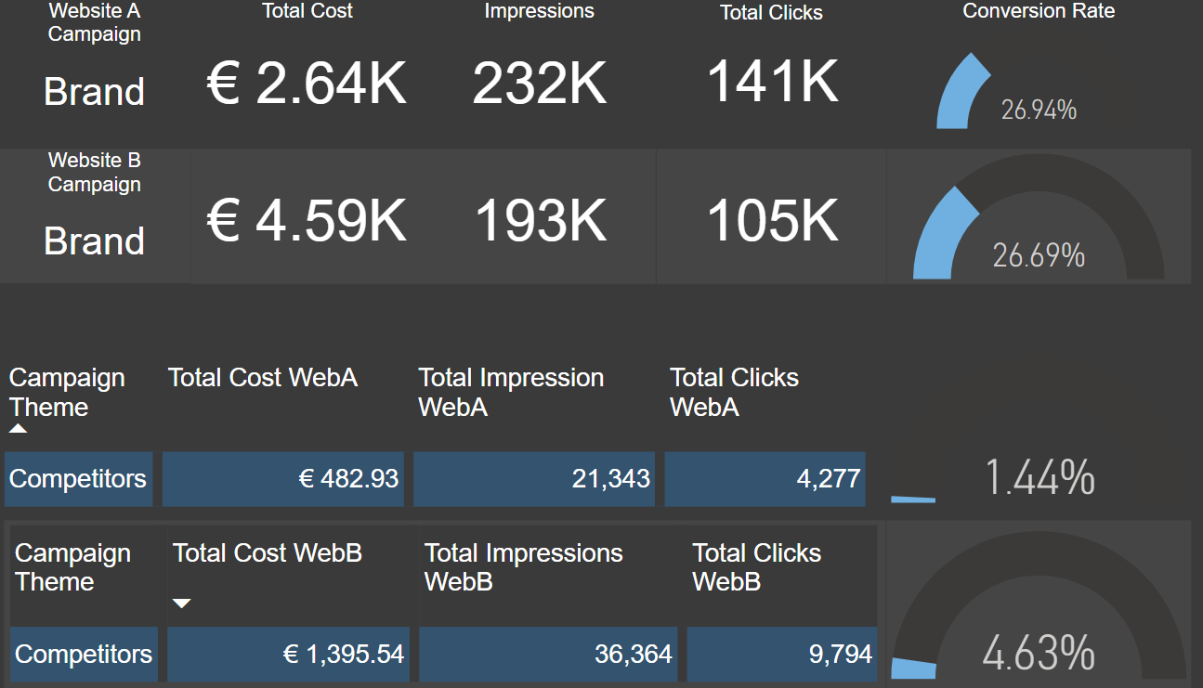
This dashboard shows the comparison between the groups of the campaign of both websites.
This is the comparison of Brand Theme and Competitors Theme from Website A and Website B. Website B spend more of its budget than Website A, but the conversion rate of Website B is higher from Website A.

Slide 5
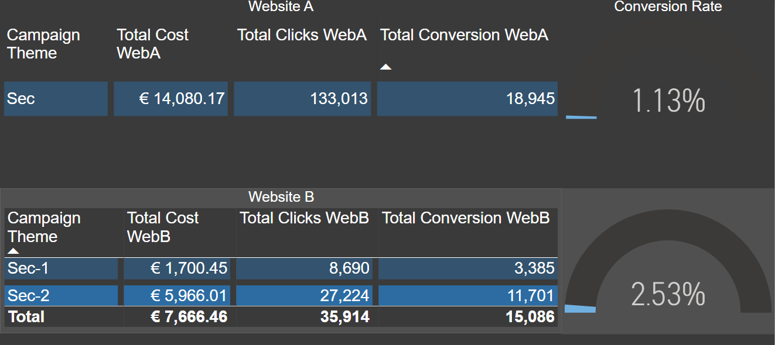
The Sector Campaign Theme of Website A has more total clicks than Website B but the conversion is a lot lesser.
Whereas, from Website B, the sector is divided into two subsections (Sec-1 and Sec-2) and the total cost of both sections comparatively is less than Website A and has a much higher Conversion Rate.

Slide 6
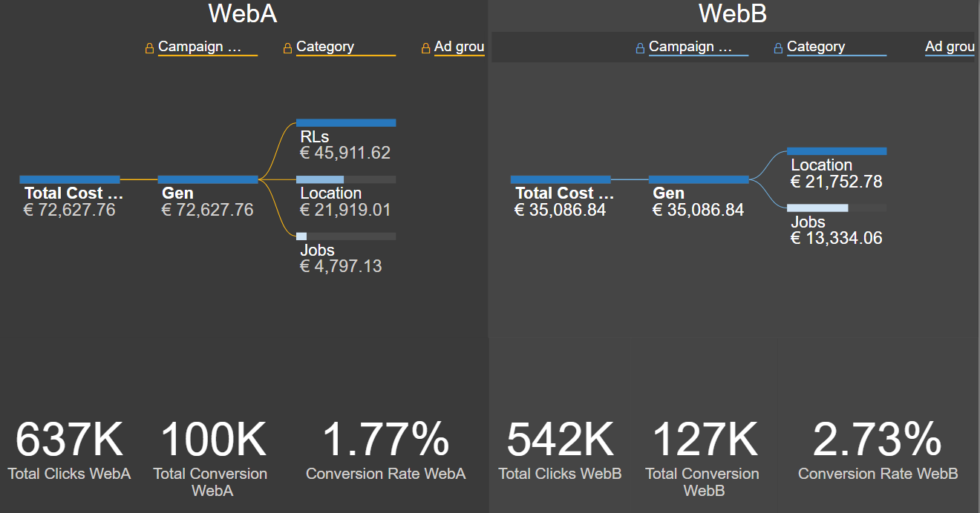
This is the comparison of Generic Result List, Generic Location, Generic Job based between both website.
Website B do not have Generic Result List category; however, the conversion and conversion rate is higher.

Slide 7
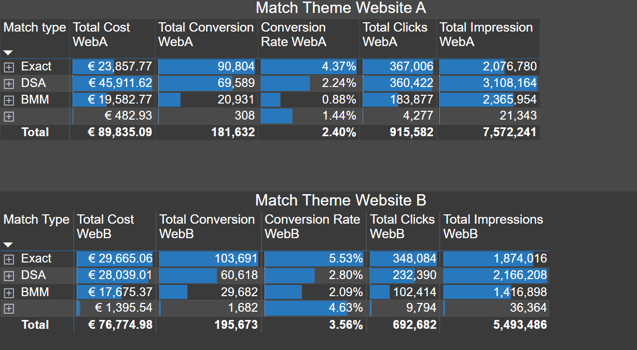
This slide shows the detailed comparison between the Match types from both websites.
The Category of match search type is EXACT, Dynamic Search Ads (DSA), and Broad Match Modifier (BMM).
From the both websites A and B, the Conversion Rate is higher in the Exact match and Website B has more conversion than Website A.

Slide 8
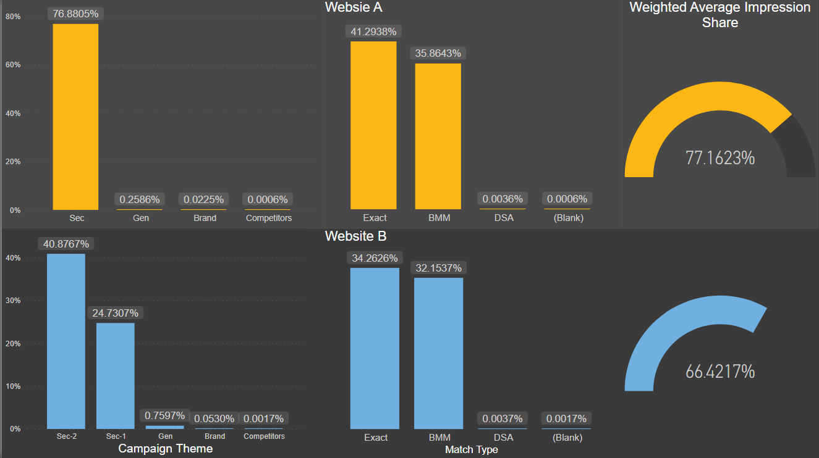
This slide shows the comparison of overall performance in weighted average impression share in percent.
Website B has less Search Impression Share as compared to Website A, but the conversion rate is high.

Slide 9
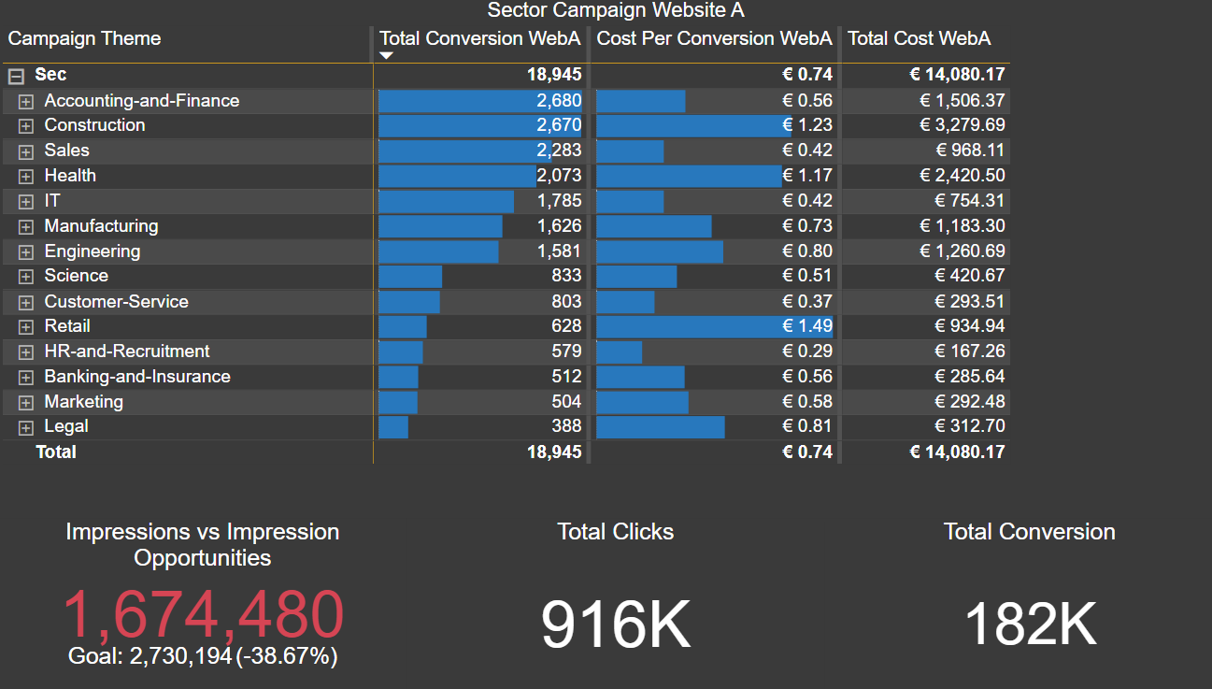
This slide shows the performance in detail of the Sector Campaign from the Website A.
It includes KPI such as Total Cost, Total Clicks and Impression opportunities vs the Impressions happened, etc.

Slide 10
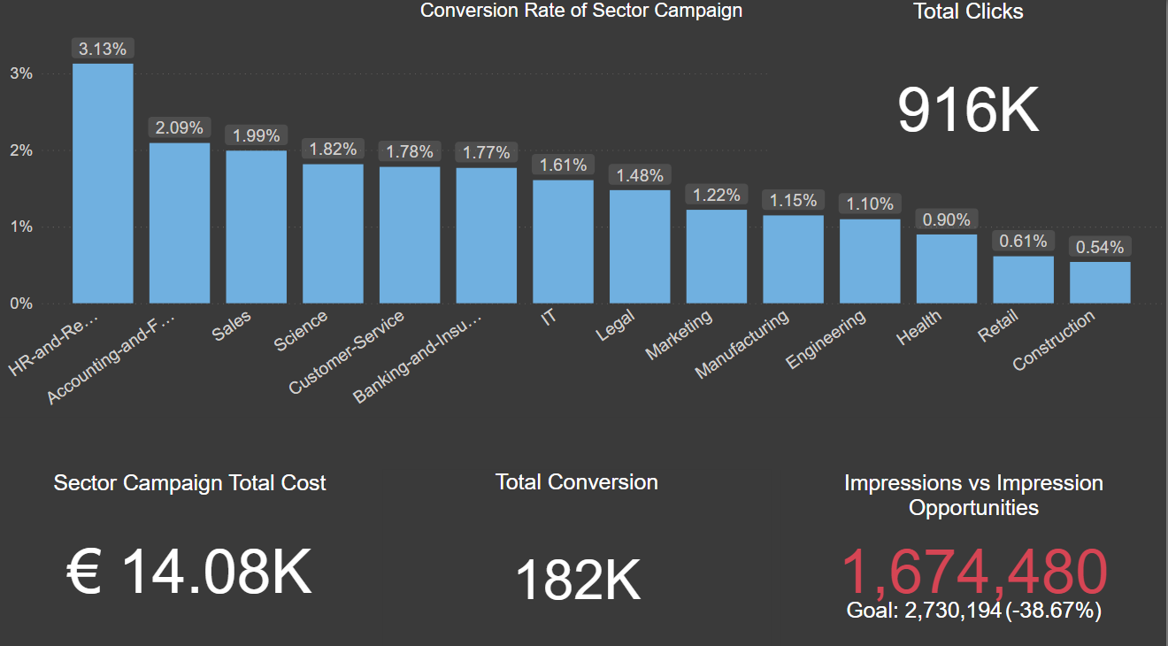
This is more simplified dashboard of the Sector Campaign.
This dashboard shows each section of the campaign with details by Conversion Rate.

Slide 11

Conclusion
Website B is performing much better than Website A

Slide 12
Thank You

Slide 13
Questions?

